Slide 1






Department of AI / DS
SEMANTIC KEYWORD
EXTRACTION &
CORPUS INDEXING
FRAMEWORK
Project Review 2 | NLP & Data Structures
Presented By :
Guided By :
Team - 1
Anita P

Slide 2

Problem Statement
Modern organizations manage vast document collections — research papers, reports, and records — that grow faster than manual review allows. Traditional keyword search relies on exact string matching, which is slow, error-prone, and fails to capture related meanings (e.g., "car" vs. "automobile").
There is a critical need for a lightweight, efficient retrieval framework that combines meaningful keyword processing with fast DSA-based indexing to handle small/medium corpora within Java constraints.

Slide 3
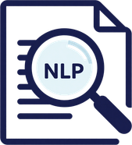

Project Objectives
Processing Goals
Implementation Goals
Prepare raw text data for analysis through a structured NLP pipeline.
Build a functional Java prototype using core data structures and algorithms.
Preprocess text: clean, tokenize, and remove stop-words from documents.
Build an inverted index mapping keywords to relevant documents.
Extract meaningful keywords using graph-based or statistical methods.
Retrieve documents quickly from user queries using the index.
Ensure efficient, scalable retrieval for small/medium corpora.
Implement entirely in Java using DSA: HashMap, HashSet, ArrayList.

Slide 4
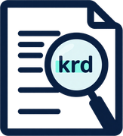
Literature Review:
Keyword Extraction
RAKE Method
RAKE (Rapid Automatic Keyword Extraction) splits text at stop-words and phrase delimiters to identify candidate keywords. Word scores are based on degree and frequency ratios — fast and language-independent.
TextRank uses a graph-based unsupervised approach. Words are nodes; co-occurrence edges link them. PageRank-like scoring selects top keywords without any labeled training data.
Dataset: Technical reports, web content (Rose et al., 2010).
TextRank Method
Finding: Very fast extraction; works well for multi-word phrases.
Dataset: News articles, academic abstracts (Mihalcea & Tarau, 2004).
Limitation: No semantic understanding; relies on stop-word list quality.
Finding: Competitive keyword quality with no training required.
Limitation: Sensitive to window size; slower on large graphs.

Slide 5


Literature Review: Semantic Understanding
BERT & Contextual Representations
Complexity & Future Scope
BERT (Bidirectional Encoder Representations from Transformers) captures word meaning based on surrounding context, not just the word itself.
BERT requires significant computational resources (GPU, large memory) making it impractical for lightweight Java-based implementations.
"Bank" in "river bank" vs. "bank account" — context changes meaning entirely.
Training and inference are slow; not suitable for small/medium corpora with limited hardware constraints.
Context-aware embeddings improve retrieval accuracy over exact keyword matching.
BERT is identified as future scope — base implementation uses lightweight keyword extraction (TextRank/RAKE).
Ref: Devlin et al., 2019 — BERT: Pre-training of Deep Bidirectional Transformers.
Speaker note: Explain that BERT is powerful but heavy — our project uses simpler methods first, with BERT as a future upgrade path.

Slide 6
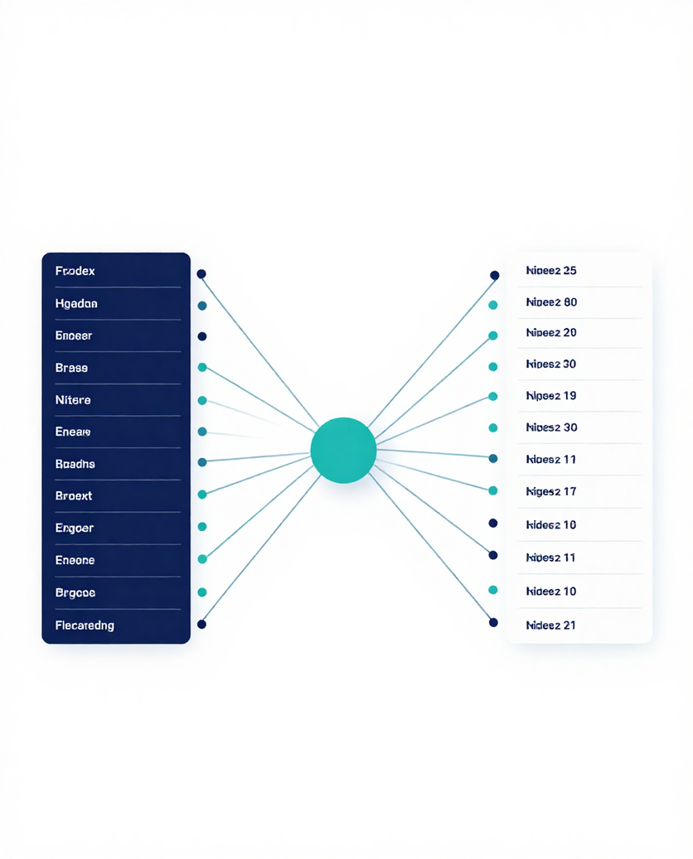

Rimberio University
Literature Review: Corpus Indexing
An inverted index maps each unique keyword to the list of documents containing it. Instead of scanning every document per query, the system looks up the keyword directly and retrieves only relevant document IDs — dramatically speeding up search.
Inverted Index Mechanism
Keyword → Document mapping enables O(1) average-case lookup via HashMap.
Avoids full-corpus scanning; retrieval scales to large collections efficiently.
Ref: Manning et al., Introduction to Information Retrieval, Cambridge, 2008.

Slide 7

Research Gap
The Missing Link
Prior studies address each component in isolation — keyword extraction, semantic modeling, or document retrieval — but rarely combine them into a single cohesive, lightweight system.
No lightweight, educationally transparent framework exists that combines meaningful keyword processing with DSA-based inverted indexing, suitable for small/medium corpora under Java constraints.
What Existing Work Covers
Gap: No unified pipeline from raw text → keywords → inverted index in a single Java-based DSA framework.
Keyword extraction methods (TextRank, RAKE) focus on ranking terms but lack indexing integration.
Gap: Existing tools are either too heavy (BERT) or too narrow (RAKE alone) for practical academic use.
Semantic models (BERT) improve understanding but are computationally heavy and complex to implement.
Our work bridges this gap with a clean, understandable, and efficient end-to-end solution.
Inverted index research optimizes retrieval but assumes pre-processed, well-structured input.

Slide 8
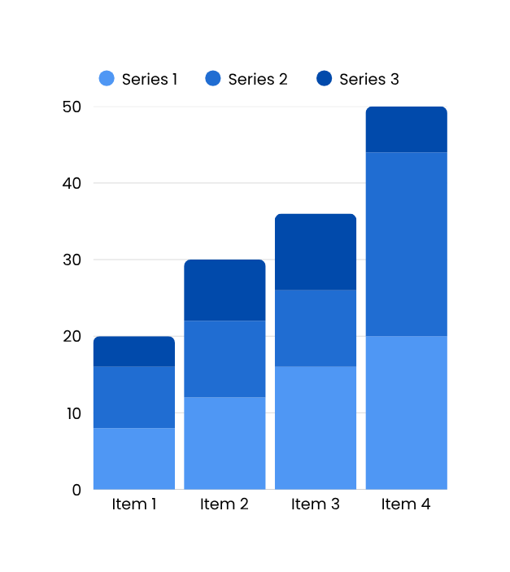
Proposed Methodology
Pipeline Flow
Processing Pipeline Overview:
Documents → Cleaning → Tokenization → Stop-word Removal → Keyword Extraction → Inverted Index → User Query → Relevant Documents
Each stage reduces noise and structures data for fast, accurate retrieval.
Stage Details:
• Cleaning: remove punctuation, lowercase text
• Tokenization: split text into individual terms
• Stop-word Removal: eliminate common words ("the", "is")
• Keyword Extraction: retain meaningful terms (RAKE/TextRank)
• Inverted Index: map keyword → document list (HashMap)
• Query Processing: tokenize & look up in index
• Output: ranked list of relevant documents
Speaker Note: Walk through each arrow step-by-step. Emphasize that the inverted index is built once offline, making live queries very fast — O(1) lookup with HashMap.

Slide 9

DSA & Algorithms Used
Algorithms & Complexity
Tokenization: split text on whitespace/punctuation using String.split() — O(n) per document. Stop-word removal via HashSet lookup — O(1) per token.
Core data structures and algorithms power efficient keyword storage and document retrieval. Each component is chosen for clarity, performance, and Java compatibility.
Inverted Index Build: iterate all tokens, insert into HashMap — O(N·k) total where N = docs, k = avg tokens.
Data Structures
HashMap<String, List>: maps each keyword to its document list — O(1) average lookup.
Query Retrieval: single HashMap.get(keyword) — O(1); multi-keyword: intersect ArrayLists — O(m).
HashSet: removes duplicate tokens during preprocessing — O(1) add/check.
Optional Trie: prefix-based autocomplete for queries — O(L) insert/search where L = keyword length.
ArrayList: stores ordered document IDs per keyword — O(1) append.

Slide 10
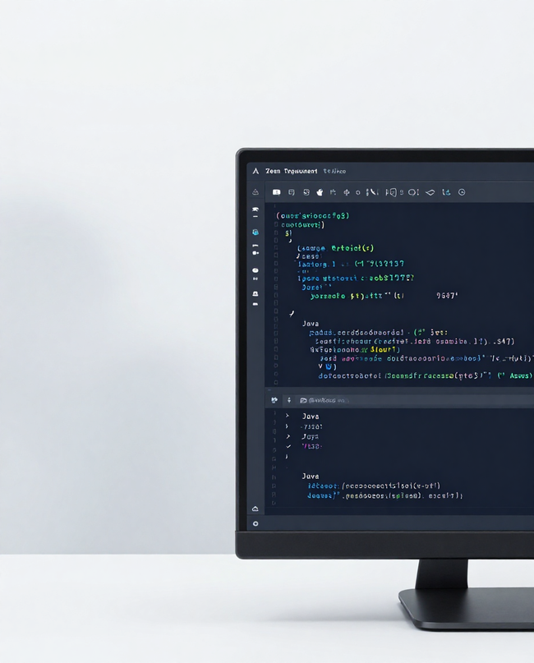
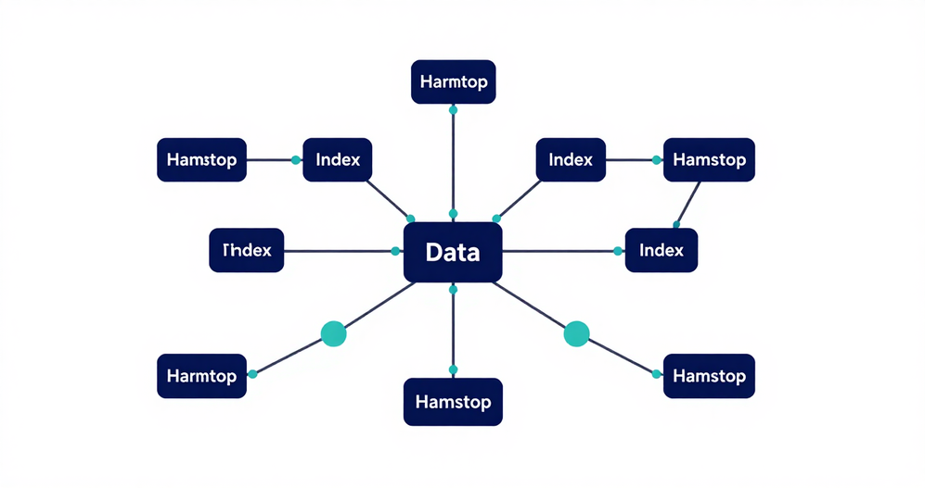
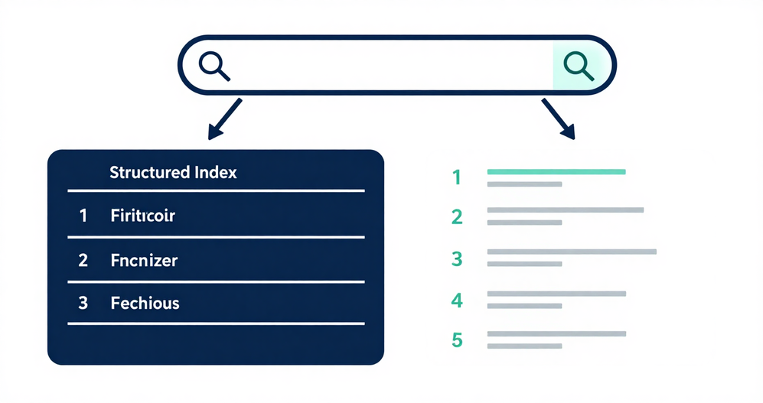
Expected Outcome
✔ Faster Search — Inverted index enables sub-linear query resolution; only relevant document lists are scanned instead of the full corpus.
✔ Organized Index — A structured HashMap (keyword → document list) provides a clean, queryable knowledge store for any small/medium corpus.
✔ Reduced Unnecessary Scanning — Stop-word removal and keyword filtering shrink index size, lowering both memory usage and lookup time.
✔ Practical DSA Application — HashMap, HashSet, ArrayList, and optional Trie demonstrate core data-structure concepts in a real retrieval context.
✔ Java Prototype — A fully functional, readable Java implementation validates the pipeline end-to-end and serves as a foundation for future extensions.
Speaker note: Walk through each bullet with a one-sentence example — e.g., "Without an index, searching 10,000 docs takes O(n); with our inverted index it takes O(1) for the lookup step."

Slide 11

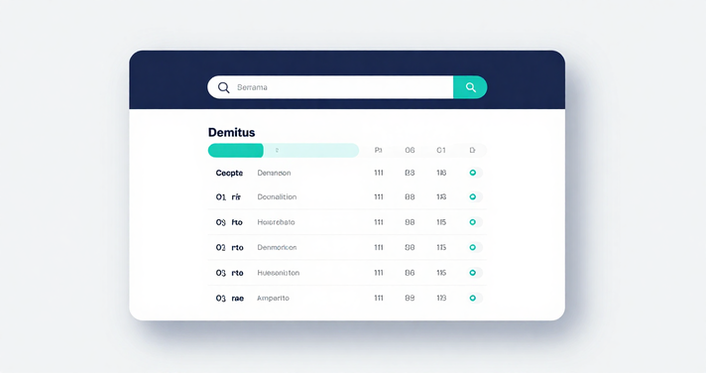
THANK
YOU!

